Slide 1
MECM Admin role support

Slide 2
MECM User Roles
Tenant already supported in v0.9
Guest already supported in v1.0
Administrator requirement to support in v1.1

Slide 3
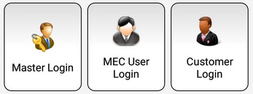
Existing MECM user roles
Tenant: These users have full permission on corresponding tenant it includes
i. Edge configurations(Host, Applcm, Apprule, Appstore).
ii. Application package distribution.
iii. Application LCM operations.
iv. Query host KPI and capabilities.
Query API’s returns data related to a tenant.
Guest: These users have read only permissions.
Tenant
Guest

Slide 4
New MECM Administrator user role support
Administrator: These users have full permission on all tenants it includes
i. Edge configurations(Host, Applcm, Apprule, Appstore) for selected tenant.
ii. Application package distribution for selected tenant.
iii. Application LCM operations for selected tenant.
iv. Query host KPI and capabilities for selected tenant.
v. Query distribution status of application packages of all tenants.
vi. Query application instance info records of all tenants.
vii. Query edge configurations(Host, Applcm, Apprule, Appstore) of all tenants.
Edge configurations(Host, Applcm, Apprule, Appstore) permission should be allowed only to admin as admin has better understanding of underlying infra and is shared among all tenants.
Admin
Note: all query API’s should return tenant id in response body.

Slide 5
Changes to existing Tenant user role
Tenant: These users have permission to
i. Distribute Application Package.
ii. Application LCM operations.
iii. Query host KPI and capabilities.
Edge configurations(Host, Applcm, Apprule, Appstore) permission to be removed as hosts are shared among all tenants.
Tenant

Slide 6
Interface changes
Current API’s include tenant-id as part of URL, we can retain as it is or tenant-id can removed from URL and send it as part of request header.
MECM-FE has to send the tenant-id in the request(header/url) for a selected tenant to perform operations.

Slide 7
Interface changes
Admin
mecm-fe
user-mgmt
appo
inventory
apm
Lcm Ctrl
Get all Tenants
Select tenant to perform operations
Configure applcm, host, app rule etc….
preAuthorize request, role MECM_ADMIN is allowed
/inventory/v1/tenants/{tenant_id}/applcms
Tenant-id can part of url or header
/apm/v1/tenants/{tenant_id}/packages
On-board application package
preAuthorize request,role MECM_ADMIN/MECM_TENANT is allowed
Instantiate app
/appo/v1/tenants/{tenant_id}/app_instances/{app_instance_id}
preAuthorize request, role MECM_ADMIN/MECM_TENANT is allowed
/inventory/v1/tenants/{tenant_id}/mechosts/{mechost_ip}/k8sconfig
preAuthorize request with role MECM_ADMIN/MECM_TENANT_MECM_GUEST is allowed

Slide 8
Interface changes: New query all APIs from admin user
Admin
mecm-fe
?
appo
inventory
apm
GET /inventory/v1/applcms
GET /inventory/v1/hosts
GET /inventory/v1/apprules
GET /inventory/v1/appStore
Query applcm, host, app rule etc….
preAuthorize request, role MECM_ADMIN allowed
Query application package
GET /apm/v1/tenants/packages
preAuthorize request, role MECM_ADMIN is allowed
Get app Inst info
GET /appo/v1/app_instance_infos
preAuthorize request, role MECM_ADMIN is allowed

Slide 9
Interface change: query APIs
Admin
mecm-fe
?
appo
inventory
apm
Get all Tenants
Select tenant to perform operations
GET /inventory/v1/tenants/{tenant_id}/applcms
GET /inventory/v1/tenants/{tenant_id}/hosts
GET /inventory/v1/tenants/{tenant_id}/apprules
Query applcm, host, app rule etc….
Tenant-id can part of url or header
preAuthorize request with role MECM_ADMIN/MECM_TENANT/MECM_GUEST allowed
Query application package
GET /apm/v1/tenants/{tenant_id}/packages
preAuthorize request with role MECM_ADMIN/MECM_TENANT/MECM_GUEST is allowed
Get app Inst info
GET /appo/v1/tenants/{tenant_id}/app_instance_infos
preAuthorize request with role MECM_ADMIN/MECM_TENANT/MECM_GUEST is allowed

Slide 10
MECM-FE design (TBD: yangyang)

Slide 11
THANK YOU

Slide 12
Backup Slides

Slide 13
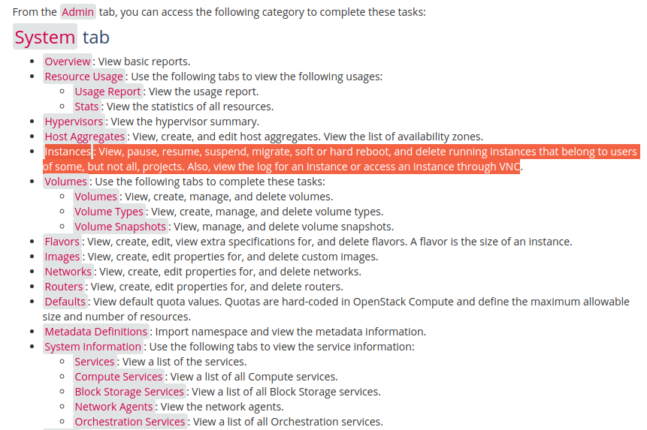
Openstack
Administrative operations¶
The administrator can run any openstack command on behalf of projects by specifying an Identity project
https://docs.openstack.org/ocata/user-guide/dashboard-log-in.html
https://docs.openstack.org/horizon/latest/admin/manage-instances.html
https://docs.openstack.org/horizon/latest/user/launch-instances.html
https://ask.openstack.org/en/question/2032/create-admin-user-within-single-tenant/#:~:text=By%20default%20the%20admin%20role,objects%20owned%20by%20ANY%20TENANT.

Slide 14
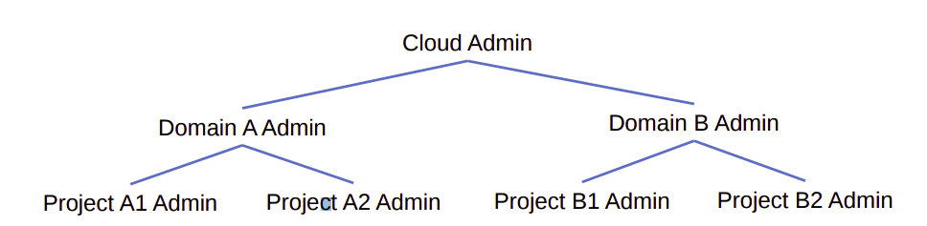
Administrators(system admin, project admin, domain admin)
Users with admin on the system should be able to manage every aspect of the deployment.
Users with admin on a project shouldn’t be able to manage things outside the project because it would violate the tenancy of their role assignment
System administrators are allowed to manage every resource
System administrators are typically operators and cloud administrators. They can control resources that ultimately affect the behavior of the deployment. For example, they can add or remove services and endpoints in the catalog, create new domains, add federated mappings, and clean up stale resources, like a user’s application credentials or trusts.
Domain Administrators:
Domain administrators can manage most aspects of the domain or its contents. These users can create new projects and users within their domain. They can inspect the role assignments users have on projects within their domain.
Domain administrators aren’t allowed to access system-specific resources or resources outside their domain. Users that need control over project, group, and user creation are a great fit for domain administrators.
https://docs.openstack.org/ocata/user-guide/dashboard-log-in.html

Slide 15
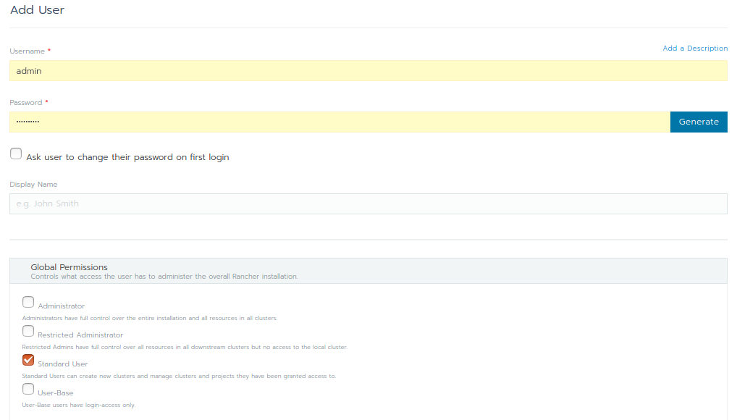
Rancher
Administrator: These users have full control over the entire Rancher system and all clusters within it.
Restricted-admin: role was created in Rancher v2.5 in order to prevent privilege escalation from the local Rancher server Kubernetes cluster. This role has full administrator access to all downstream clusters managed by Rancher, but it does not have permission to alter the local Kubernetes cluster.
Standard User: These users can create new clusters and use them.
User-Base: User-Base users have login-access only.

Slide 16
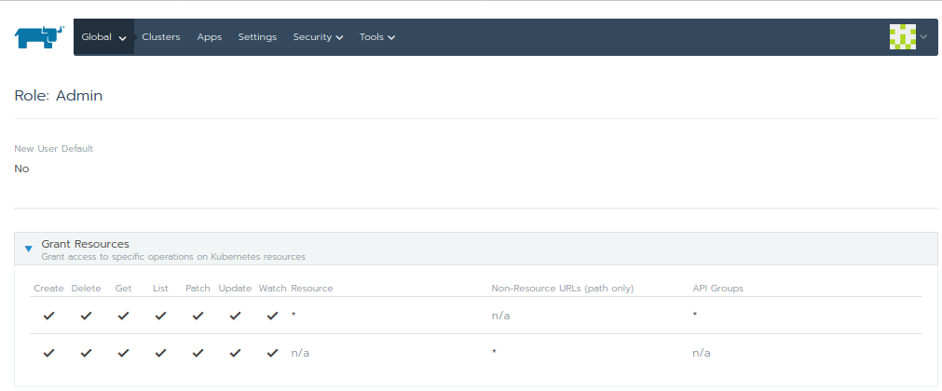
https://www.youtube.com/watch?v=-ZhiaF6BD5o

Slide 17
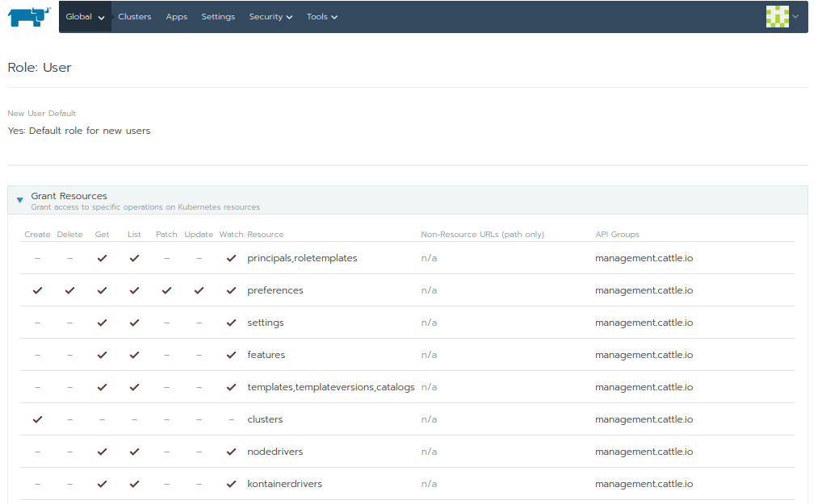
https://rancher.com/docs/rancher/v2.x/en/cluster-admin/cluster-access/cluster-members/?query=project
https://rancher.com/docs/rancher/v2.x/en/deploy-across-clusters/multi-cluster-apps/

Slide 19
Backup slides

Slide 20
MECM Administrator user role support - soln 1
Allow Admin to have full access rights on all tenant’s resources.
Allow Admin to view all the tenants (query user-mgmt for all tenants info).
Allow Admin to perform app/update/delete action(config/lcm) on any selected tenant.
Allow admin to view configurations, distribution/deployment info of all tenants.
Allow admin to add/update/delete edge configuration i.e, Applcm, AppruleMgr, AppStore, MecHost for a particular tenant.
Note: Allow only admin to create edge configurations(applcm, apprule, mechost, appstore).

Slide 21
Interface change to support admin operations.
Allow admin to add/update/delete edge configuration i.e, Applcm, AppruleMgr, AppStore, MecHost for a particular selected tenant with role as MECM_admin in the token.
mecm-fe has to form mecm-be URL’s with the admin selected tenant ID for any actions (edge config i.e, Applcm, AppruleMge, AppStore, MecHost, application lcm operations and app rule configurations) or can delete tenant-id from URL’s and make tenant-id part of header.
mecm-be should provide new interface to query all the tenants configurations, distribution info and deployment informations etc… when user role is MECM_admin in the token
Modify all query interfaces to include tenant id in the response body.

Slide 22
MECM Administrator user support - Soln 2
Allow Admin to have full access rights on tenants resources.
Allow admin to view configurations, distribution/deployment info of all tenants.
Allow Admin to perform update/delete action(config/lcm) on selected resource.
Note: Allow only tenants to perform edge configurations (applcm, apprule, appstore, mechost).

Slide 23
Interface change to support admin operations.
Allow admin to update/delete edge configuration i.e, Applcm, AppruleMgr, AppStore, MecHost for a particular selected resource with role as MECM_admin in the token.
mecm-fe has to form mecm-be URL’s with the selected tenant resource for any actions (edge config i.e, Applcm, AppruleMge, AppStore, MecHost, application lcm operations and app rule configurations) or can delete tenant-id from URL’s and make tenant-id part of header.
mecm-be should provide new interface to query all the tenants configurations, distribution info and deployment informations etc… when user role is MECM_admin in the token
Modify all query interfaces to include tenant id in the response body of all the queries.

Slide 24
MECM API’s to Query KPI and software capability currently has tenant-id parameter in the URL.
Currently tenant-id parameter can be removed as same host is shared by multiple tenants.
GET /appo/v1/tenants/{tenant_id}/hosts/{host_ip}/kpi
GET /appo/v1/tenants/{tenant_id}/hosts/{host_ip}/mep_capabilities
GET /appo/v1/tenants/{tenant_id}/hosts/{host_ip}/mep_capabilities/{capability_id}
Admin

Slide 25
Soln -2 : Interface change to support admin operations.
Need modification in existing configurations APIs
Allow admin to configuration edge configurations i.e, Applcm, AppruleMgr, AppStore, MecHost at global level.
mecm-be should provide new interface to query all the tenants configurations, distribution info and deployment informations etc… when authorization role is MECM_admin in the token
Modify all query interfaces to include tenant id in the response body of all the queries.

Slide 26
Soln 2: Interface changes
Existing APIs
Modified APIs
GET /inventory/v1/tenants/{tenant_id}/applcms
GET /inventory/v1/tenants/{tenant_id}/applcms/{applcm_ip}
PUT /inventory/v1/tenants/{tenant_id}/applcms/{applcm_ip}
POST /inventory/v1/tenants/{tenant_id}/applcms
DELETE /inventory/v1/tenants/{tenant_id}/applcms
DELETE /inventory/v1/tenants/{tenant_id}/applcms/{applcm_ip}
GET /inventory/v1/tenants/{tenant_id}/appstores
POST /inventory/v1/tenants/{tenant_id}/appstores
DELETE /inventory/v1/tenants/{tenant_id}/appstores
GET /inventory/v1/tenants/{tenant_id}/appstores/{appstore_ip}
PUT /inventory/v1/tenants/{tenant_id}/appstores/{appstore_ip}
DELETE /inventory/v1/tenants/{tenant_id}/appstores/{appstore_ip}
GET /inventory/v1/tenants/{tenant_id}/mechosts
POST /inventory/v1/tenants/{tenant_id}/mechosts
DELETE /inventory/v1/tenants/{tenant_id}/mechosts
GET /inventory/v1/tenants/{tenant_id}/mechosts/{mechost_ip}
PUT /inventory/v1/tenants/{tenant_id}/mechosts/{mechost_ip}
DELETE /inventory/v1/tenants/{tenant_id}/mechosts/{mechost_ip}
GET /inventory/v1/tenants/{tenant_id}/mechosts/{mechost_ip}/capabilities
GET /inventory/v1/tenants/{tenant_id}/mechosts/{mechost_ip}/capabilities/{capability_type}/applications
POST /inventory/v1/tenants/{tenant_id}/mechosts/{mechost_ip}/k8sconfig
DELETE /inventory/v1/tenants/{tenant_id}/mechosts/{mechost_ip}/k8sconfig
GET /inventory/v1/tenants/{tenant_id}/apprulemanagers
GET /inventory/v1/tenants/{tenant_id}/apprulemanagers/{app_rule_manager_ip}
DELETE /inventory/v1/tenants/{tenant_id}/apprulemanagers
DELETE /inventory/v1/tenants/{tenant_id}/apprulemanagers/{app_rule_manager_ip}
GET /inventory/v1/applcms
GET /inventory/v1/applcms/{applcm_ip}
PUT /inventory/v1/applcms/{applcm_ip}
POST /inventory/v1/applcms
DELETE /inventory/v1/applcms
DELETE /inventory/v1/applcms/{applcm_ip}
GET /inventory/v1/appstores
POST /inventory/v1/appstores
DELETE /inventory/v1/appstores
GET /inventory/v1/appstores/{appstore_ip}
PUT /inventory/v1/appstores/{appstore_ip}
DELETE /inventory/v1/appstores/{appstore_ip}
GET /inventory/v1/mechosts
POST /inventory/v1/mechosts
DELETE /inventory/v1/mechosts
GET /inventory/v1/mechosts/{mechost_ip}
PUT /inventory/v1/mechosts/{mechost_ip}
DELETE /inventory/v1/mechosts/{mechost_ip}
GET /inventory/v1/mechosts/{mechost_ip}/capabilities
GET /inventory/v1/mechosts/{mechost_ip}/capabilities/{capability_type}/applications
POST /inventory/v1/mechosts/{mechost_ip}/k8sconfig
DELETE /inventory/v1/mechosts/{mechost_ip}/k8sconfig
GET /inventory/v1/apprulemanagers
GET /inventory/v1/apprulemanagers/{app_rule_manager_ip}
DELETE /inventory/v1/apprulemanagers
DELETE /inventory/v1/apprulemanagers/{app_rule_manager_ip}

